Slide 1
Linear Regression
Algo
ML
Supervised Learning
Why Regresion?....
We use Regression for continuous real values cuz we can’t classify it.

Slide 2
CHECK POINTS
01. What is Linear Regression?
02. Why we use it?
03. How it works?
04. Types
05. Simple Linear Regression
06. Multiple Linear Regression
07. Limitations
08. Real World Use Case
09. Task

Slide 3
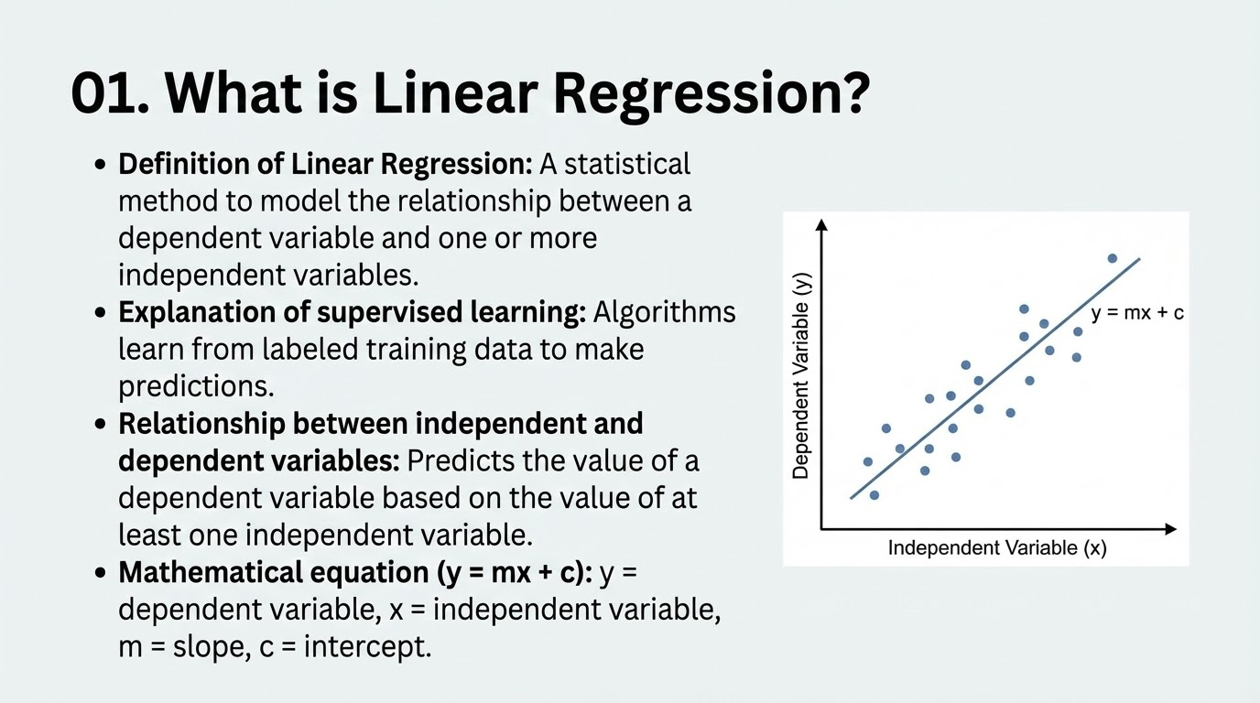

Slide 4
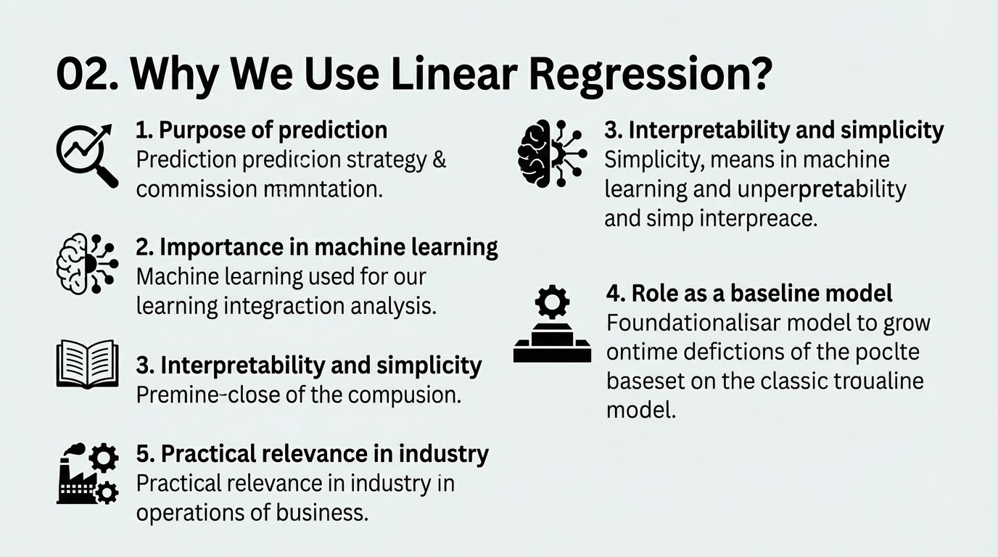

Slide 5
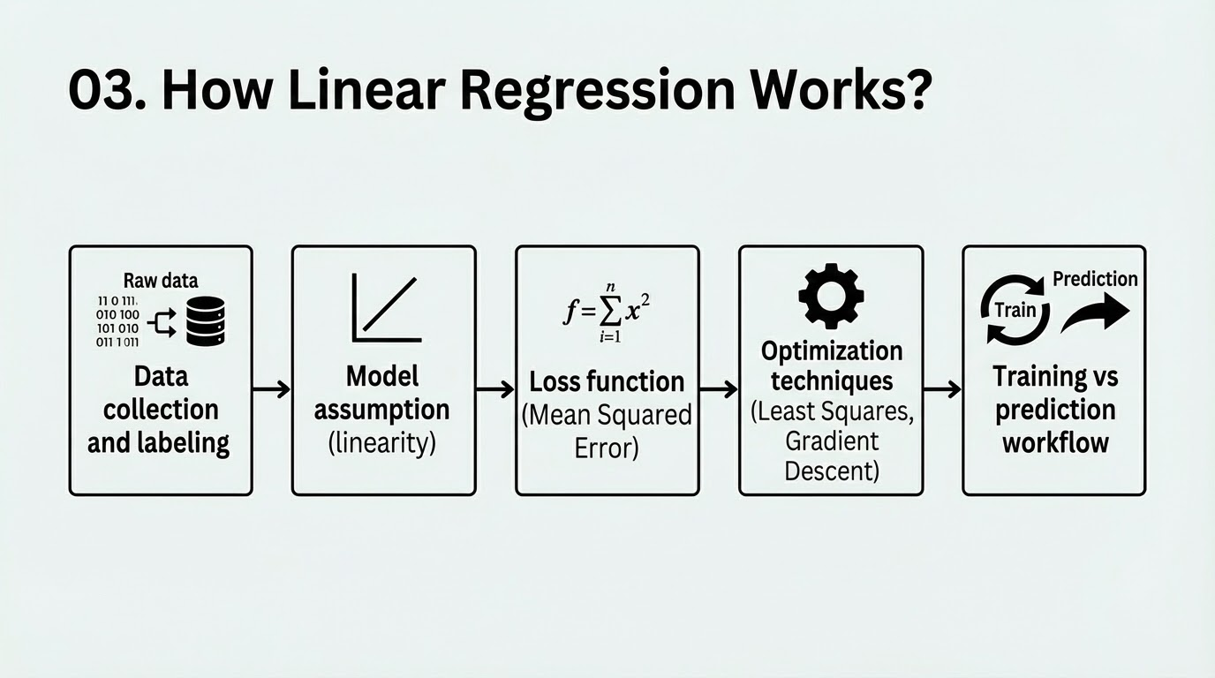

Slide 6
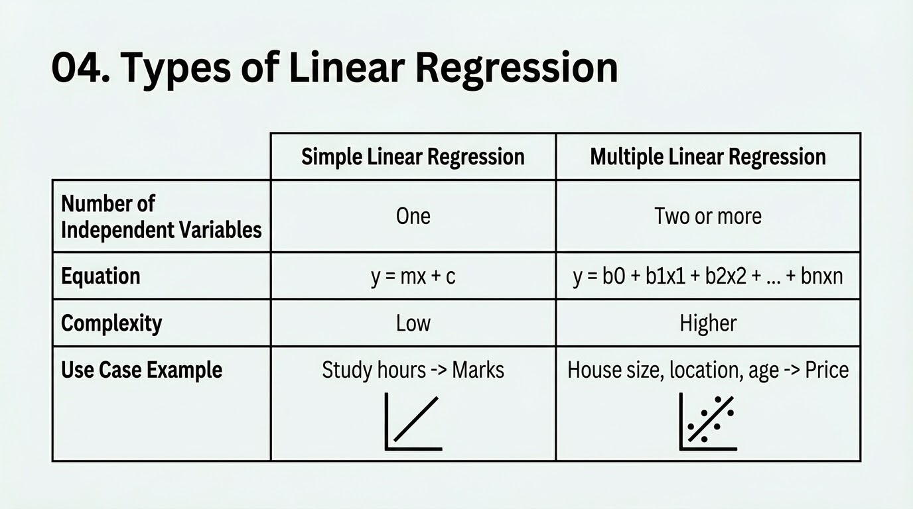

Slide 7
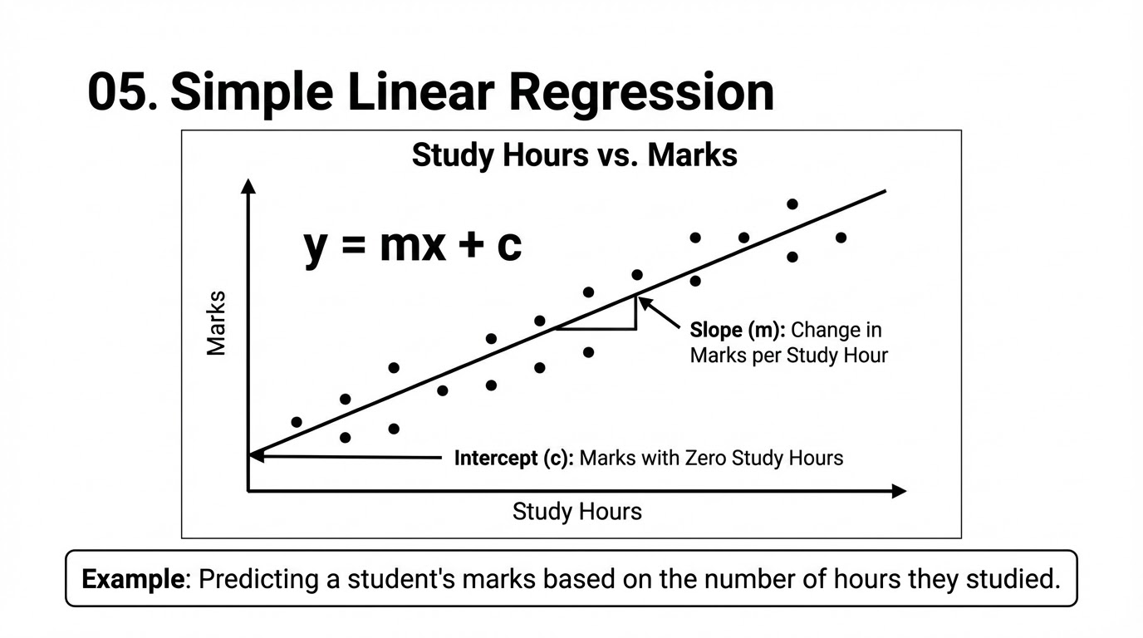

Slide 8
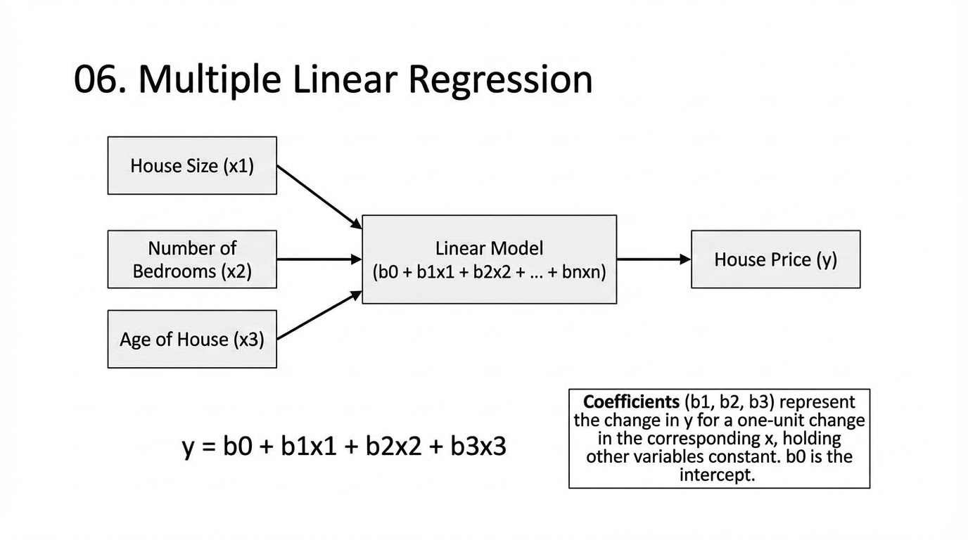

Slide 9
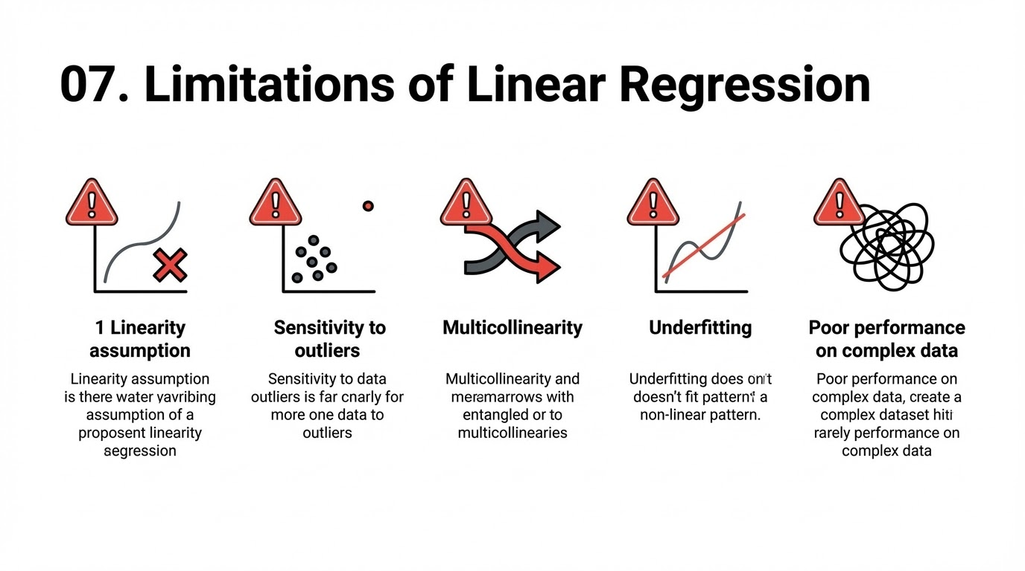

Slide 10
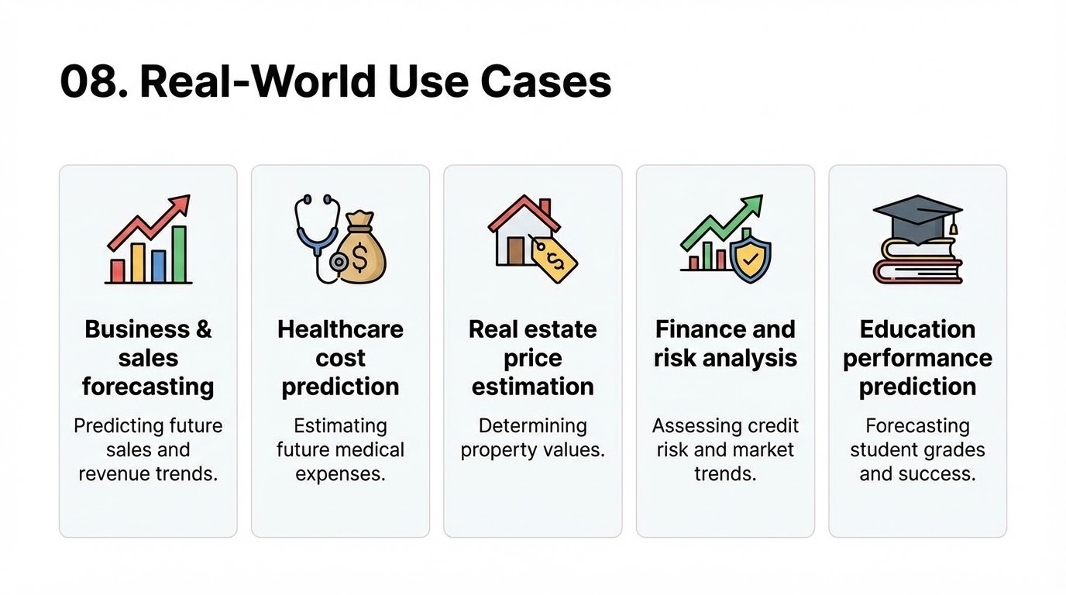

Slide 11
Task:
Click to View

